Slide 1
Investor’s Dream 2.0
Fintech - Project 2
Group 2 Collaborators:
Julian Ritchey
John Yin
Andrea Delgadillo Tomasevich
Dmitry Chalganov
Wanlin Li
Presentation Date: June 15, 2023

Slide 2
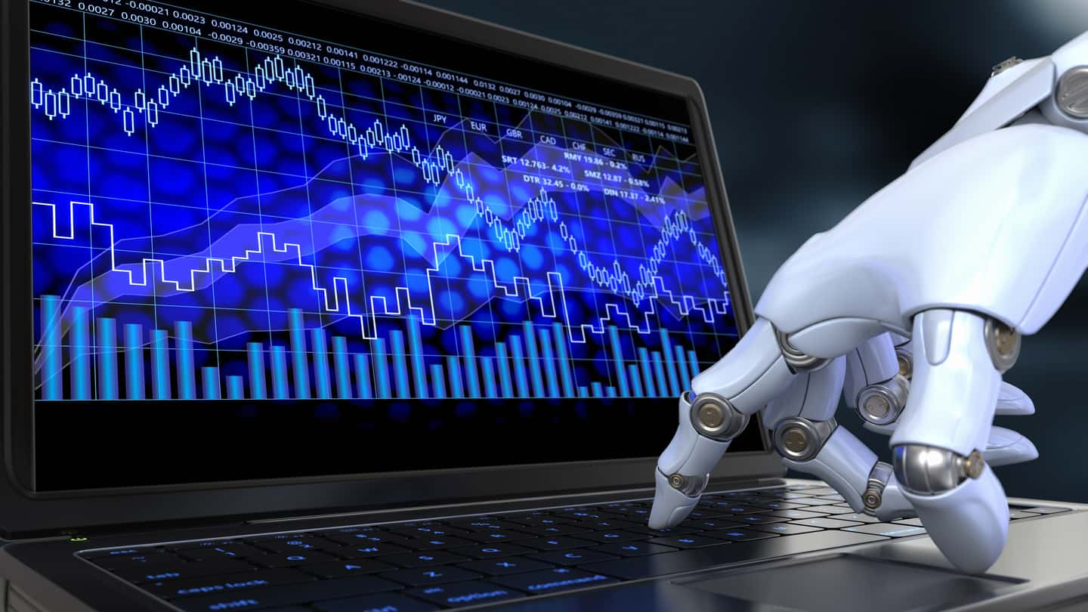
Purpose of the Project
Create an easy to use predictive trading product.

Slide 3

Important Questions
What are the potential returns for the customer?
What is the customer’s risk tolerance?
How can the customer be kept in the loop?

Slide 4
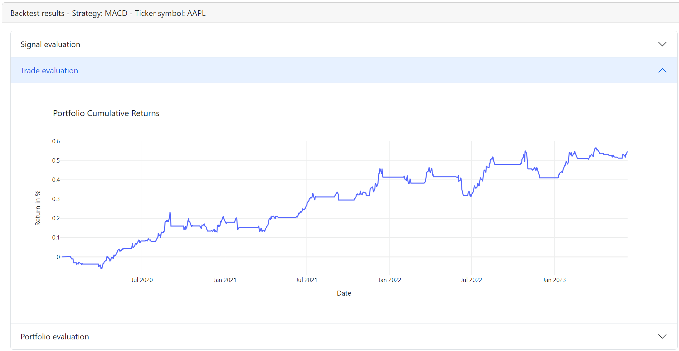
What are the potential returns for the customer?
The strategies in our product are back-tested through algorithmic trading models. The future prices of stocks are calculated through a neural network model.

Slide 5
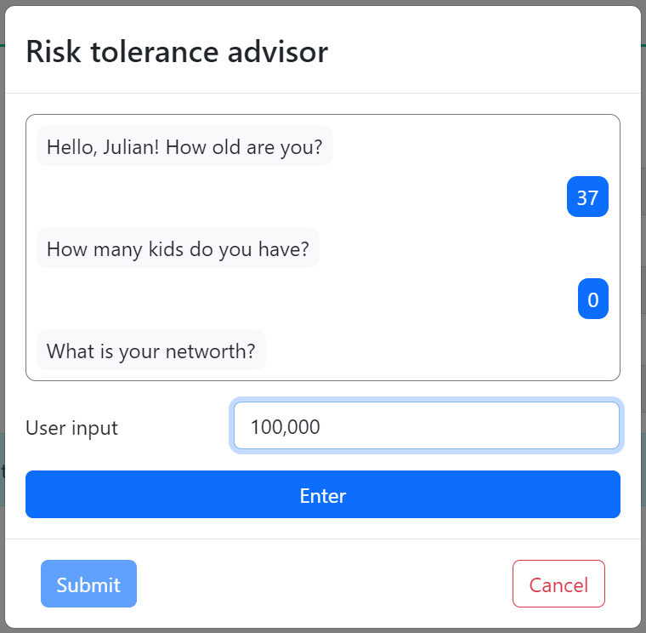
What is the customer’s risk tolerance?
The risk tolerance of a customer is evaluated through Robo Advisor (Lex Bot) and Machine Learning Model

Slide 6
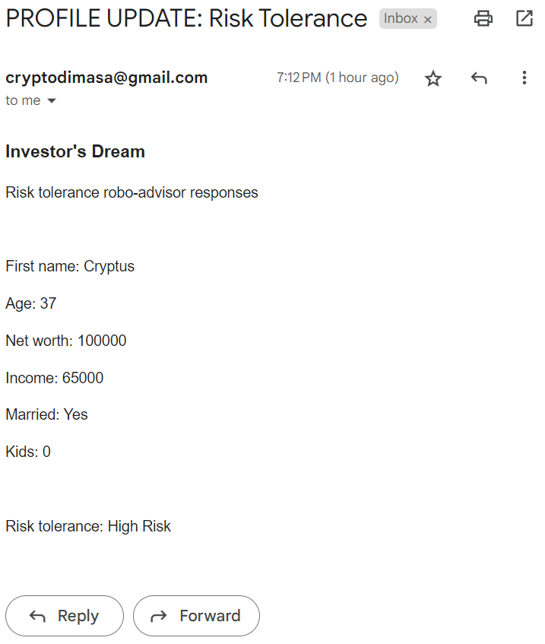
How can the customer be kept in a loop?
The customer will be notified about their risk tolerance and in the future - updates on their ongoing trades.

Slide 7
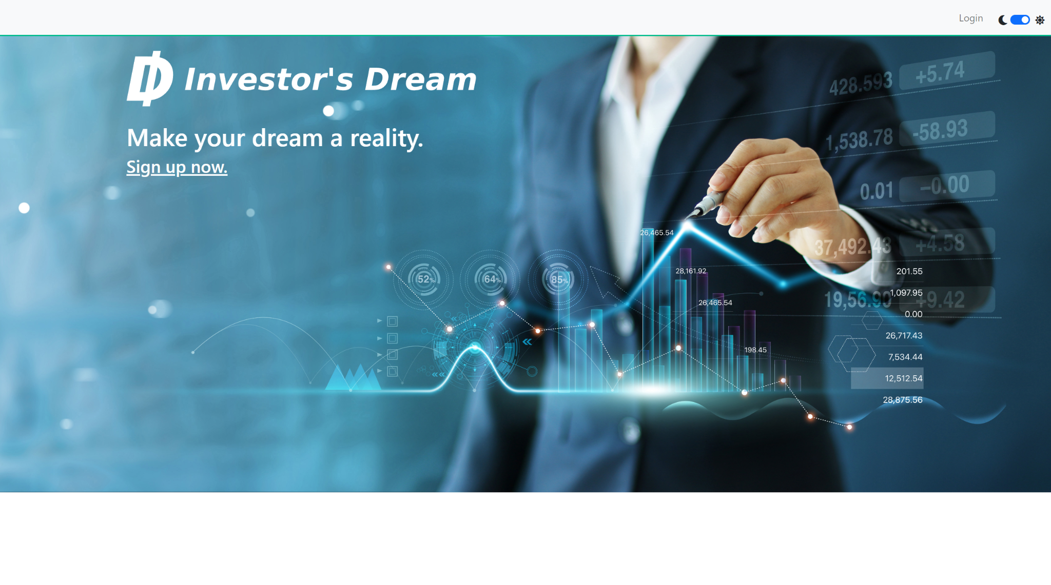
Investor’s Dream 2.0

Slide 8
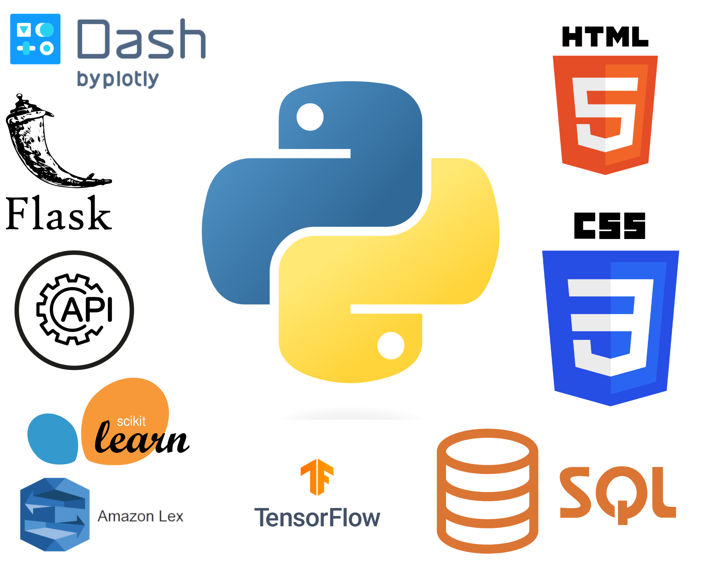
What Technology was used?
Python (main programming language)
Flask
Dash
API Calls
Tensor Flow
Scikit-Learn
Amazon Lex
SQL
HTML
CSS

Slide 9
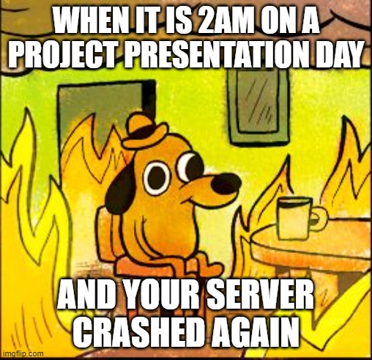
Project Difficulties
Investigating API interactions with various servers
Integrating separate developers’ code
Tweaking the trading strategy models to get best returns
Getting secure access to Gmail
Getting Lex Bot integrated with Flask/Dash
Pickling and unpickling machine-learning models

Slide 10
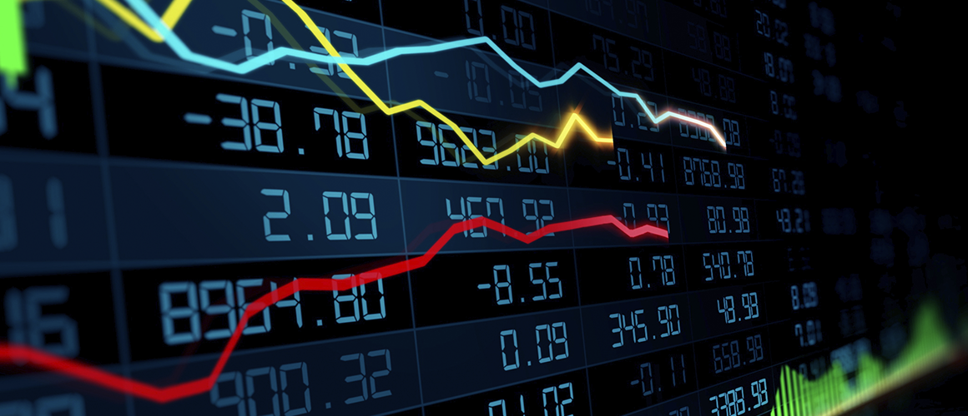
Thank You for Attention!

